Slide 1
Project – Metadata viewer/updater
Context:
Metadata is really cumbersome to navigate
We sometime have to do some manual changes to the metadata
Goal:
Create a tool to navigate and update information on the metatada.

Slide 2
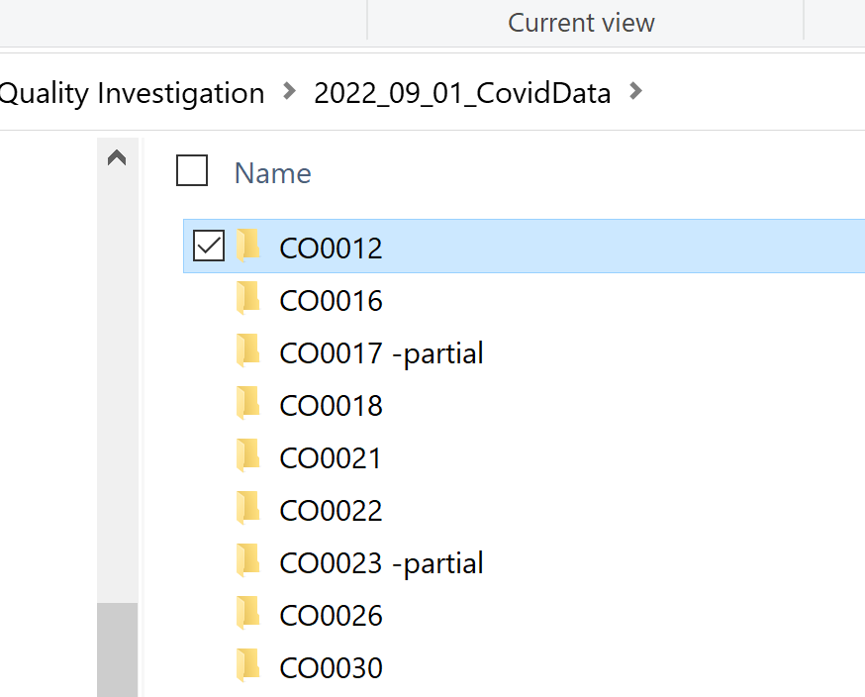
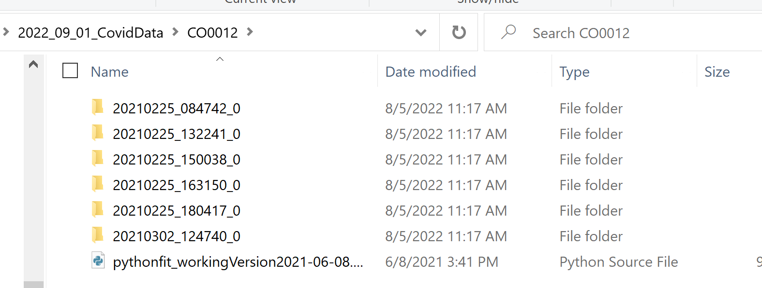
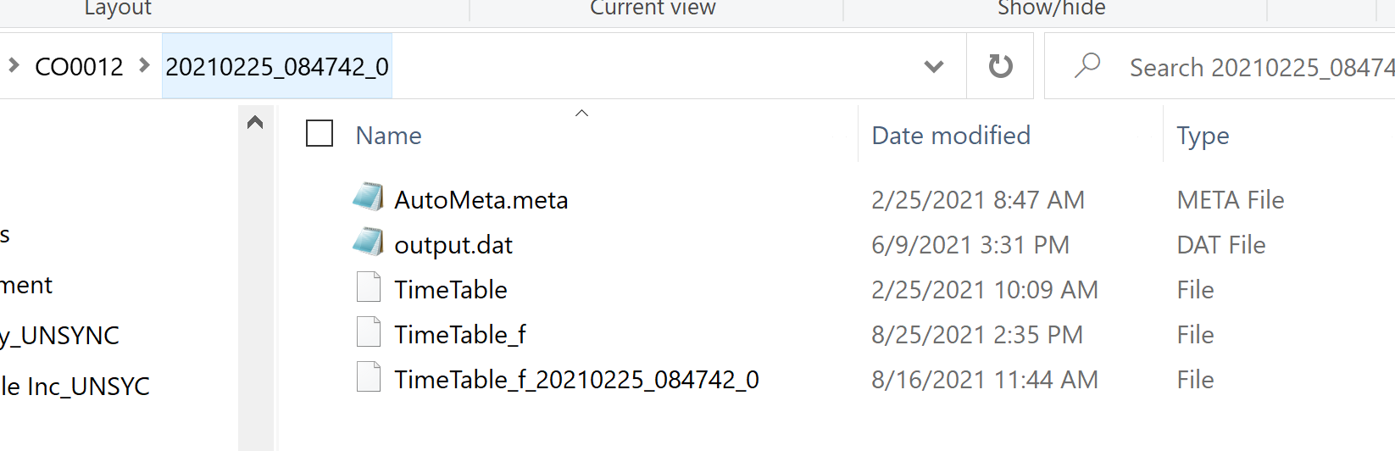
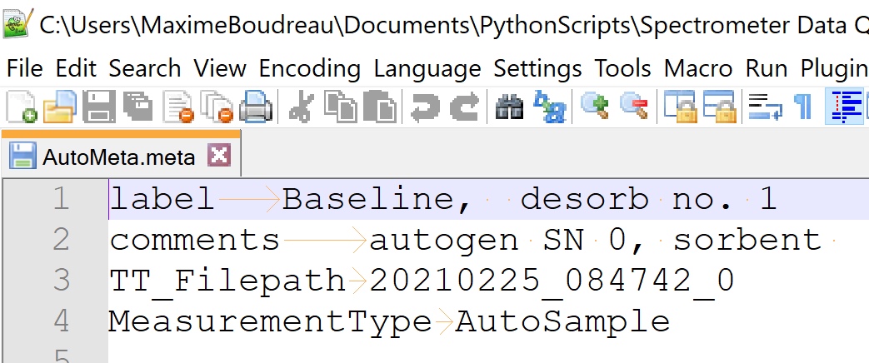

Slide 3
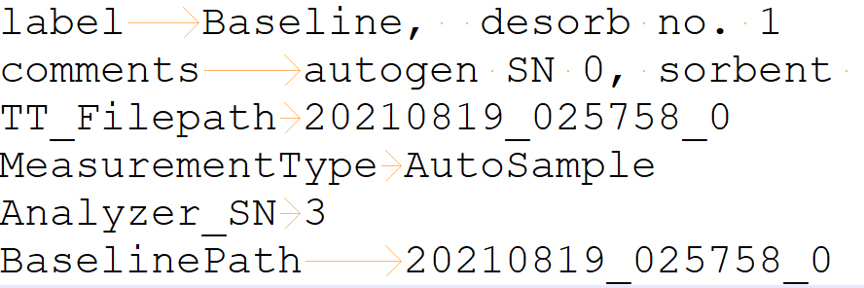
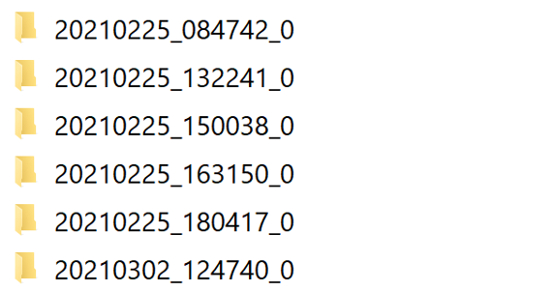
GUI - TEMPLATE
Metadata Text
Select new kit
Selected Kit
CO0012
Type
Baseline
Analyzer_SN
3
Baseline
Green Desorb 1
Desorb Number
1
BaselinePath
20210819_025758_0
Yellow Desorb 1
pink Desorb 1
Sorbent type
Tube Slot
pink Desorb 2
TT_FilePath
20210819_025758_0
Green Desorb 2
User comment
Alignment was not optimal the next morning. Crash occurred when the baseline finished.
Update Metadata

Slide 4
Requirements
Developed in the metadata mapper repository.
https://sthelen.picomole.com/tools/spectrometer-metadata-mapper
Must prevent unsanitized data to be entered.
Special care must be accorded to the formatting (inconsistent, sometime the separator is a comma, a space, or a tab…)
To be decided:
Must archive the old metadata.

Slide 5
Resources
PySimpleGUI may be the easiest package to get the stuff done
https://realpython.com/pysimplegui-python/

